Slide 1
ABC CALL VOLUME TREND ANALYSIS
Project Description:
In this project, we deal with Customer Experience (CX) Analytics where I was provided with the dataset that contains information about the inbound calls received by a company named ABC, which operates in the insurance sector.
Our objective is to solve the queries using the provided dataset such as Average call duration, call volume analysis, manpower planning, and night shift manpower planning. Where we need to estimate the number of agents required to reduce the abandon rate to less than 10% in day and night time.
Approach:
I first spent a lot of time, understanding the Business domain and thoroughly knowing each column from the dataset, and then breaking down the required columns for respective columns which can avoid confusion in solving the given questions.
Instead of applying all the Excel formulas all at a time, I inserted new columns applied the newly inserted columns to the next column, and solved queries.
Tech-Stack Used:
I used the Microsoft Excel 2021 version in this project because the project demanded providing a spreadsheet that can be done in Excel and the version was built on my computer.
Also, I was very much aware of Excel and its properties which made my work a bit easy.

Slide 2
Insights:
By doing this project I gained a lot of knowledge, especially in performing the Excel functions which included the mathematical formulas in it. I also got to know about Customer Experience Analytics and business understanding from the link provided in the project description. Now I am well aware of the CX analytics.
Also understood how to get the data based on the assumptions made and implement that data into the queries to get the output as shown in night shift manpower planning. The key findings, meaningful trends, and patterns are discussed from the upcoming slide.
Result:
I conclude that this project made my Excel skills even stronger and also got to know about a new domain called Customer Experience (CX) analytics. This domain understanding helped to learn more about the ABC Call Volume analysis.
The queries in this project were not directly solved but depended on various factors that we needed to calculate using mathematical functions.
LINK TO THE EXCEL SHEET (CTRL + CLICK)

Slide 3
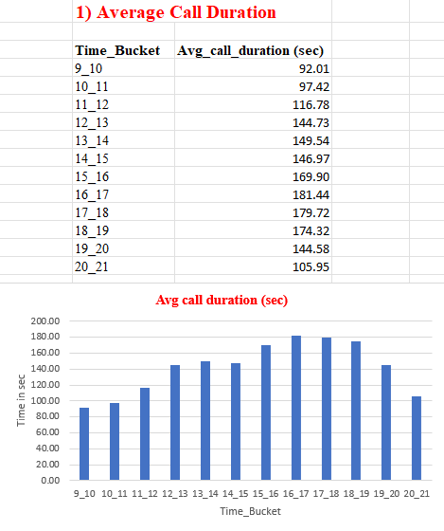
Insights and Visualization
1. Average Call Duration:
I inserted two new columns Time Bucket and Average call duration in seconds. Here, I calculate the average duration of the call in each time bucket, and from the table beside we can see that the duration is the highest at 181.44 seconds in the 16_17 time bucket and then with 179.32 seconds in the 17_18 time bucket.
The least was between 9_10 with 92 seconds of call duration since it is early in the morning people tend to avoid duration calls with the call company as they will be busy I their work. I also applied visualization graphs for the above data as they can be easily understandable and eye-pleasing as well.
Another key insight drawn from the data is that the average call duration is high in the evening from 4-5 PM which means people tend to show some interest and patience at that particular point of time.

Slide 4
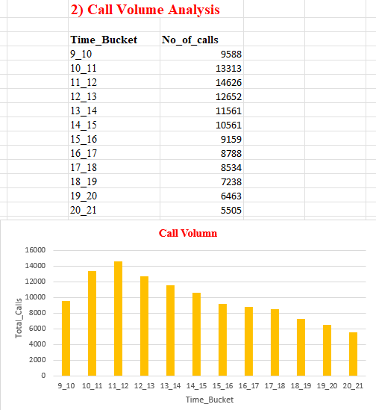
2. Call Volume Analysis:
Here I was asked to visualize the total number of calls received in each time bucket. Similar to the previous query, I inserted the time bucket column along with the number of calls column where I applied the Excel formula to find the total number of calls made in each time bucket.
Here I applied the “COUNTIF” function with the range of time bucket column and the criteria is to find separate time i.e. 9_10, 10_11, and so on up to 20_21.
Then applied the visualization to the table and chose the graph as the bar graph where the X-axis represents the time bucket and the Y-axis represents the Total calls. The highest number of calls was made at 11 AM i.e. 14,626 calls were made in that one hour and then at 10 AM recorded the second highest number of calls i.e. 13,313.
The least calls were made at 8 to 9 PM with just 5,505 calls and it was drastically decreasing as the day progressed. However, the average call duration was increasing, unlike the call volume analysis.

Slide 5
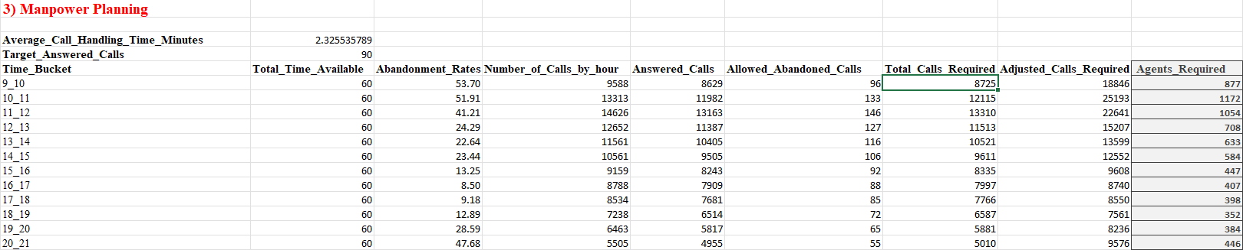
3. Manpower Planning
While finding the manpower planning, I first found the average call handling time in minutes for all 23 days and targeted answered calls means the number of calls needed to be attended so that the abandoned rate will be less than 10%. The agents required is the output of the table presented at the last and each column is interconnected to each other to avoid confusion, I highlighted the agents_required column as the output of the table.
Generally, if the ‘abandonment rate’ rate is high then the number of agents required is also high but as you can see in the above table, the agents required are higher between 10 to 11 AM where the rate is 51.91% which is less than the abandonment rate between 9 to 10 AM which is 53.705. This is because it not only depends on the abandonment rate but also the number of calls received in each hour. However, between 8 to 9 AM, the abandonment rate is the third highest among all the other agents requiring just 446 because the total calls made at that time were just 5,505 which is far less compared to other time buckets.

Slide 6
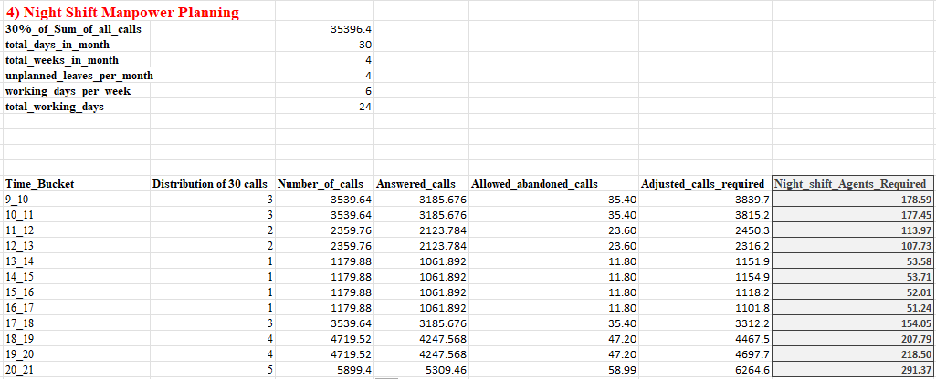
4. Night shift Manpower Planning
Similar to the Manpower planning but need to find the number of agents required at night time between 9 PM to 9 AM. Assume that for every 100 calls that customers make between 9 am and 9 pm, they also make 30 calls at night between 9 pm and 9 am. So calculating each column based on the previous table but only 30% of its values.
There are a few other assumptions made as I mentioned above, total working days for the agent in a month and the total actual working hours spent on calls with customers/users. The distribution of 30 calls is mentioned in the description so based on that number of calls is calculated. The output column depicts that 291 agents are required between 8 AM to 9 AM to reduce the abandoned rate from 58% to below 10%. The lowest number of agents required is just around 50 from 1 AM to 4 AM because the number of calls made at that time was less so the abandoned rate is also low.

